Slide 1

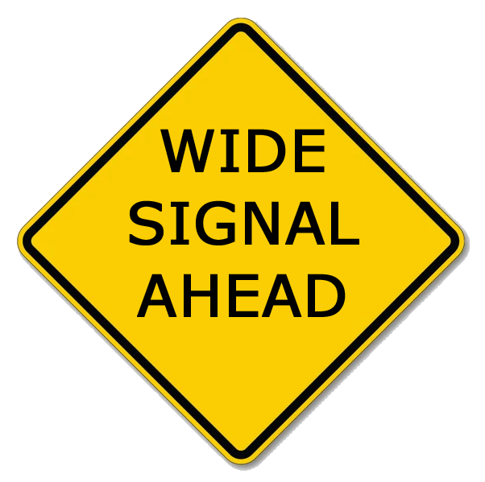


Slide 2
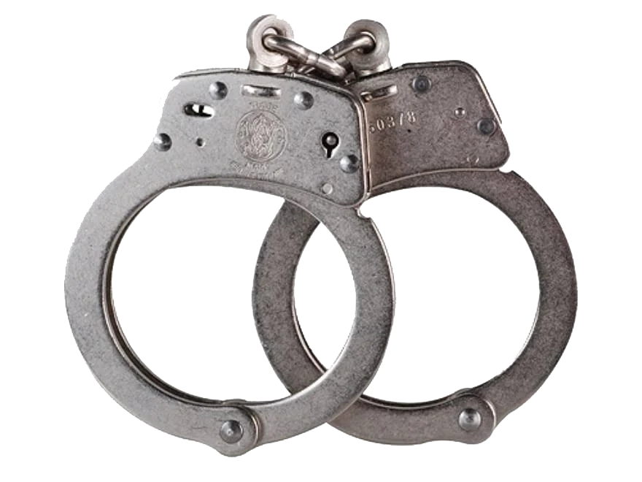
WHAT IS ESSB?
EXTENDED SINGLE SIDEBAND (ESSB)
It's a hi-fi variant of conventional SSB voice operation on the HF amateur bands. Instead of the typical ~2.4–2.8 kHz transmit bandwidth optimized for intelligibility under poor conditions, ESSB operators run roughly 4–6 kHz of audio bandwidth to get much fuller, more natural-sounding audio.
IT'S ILLEGAL, RIGHT?
In the US, FCC Part 97 sets no hard bandwidth limit on HF
phone emissions (only that it be within the phone subbands
and good engineering practice), so ESSB is legal. Other
administrations do impose bandwidth limits, so it varies by
country.
ESSB: 4K00J3E, 6K00J3E

Slide 3

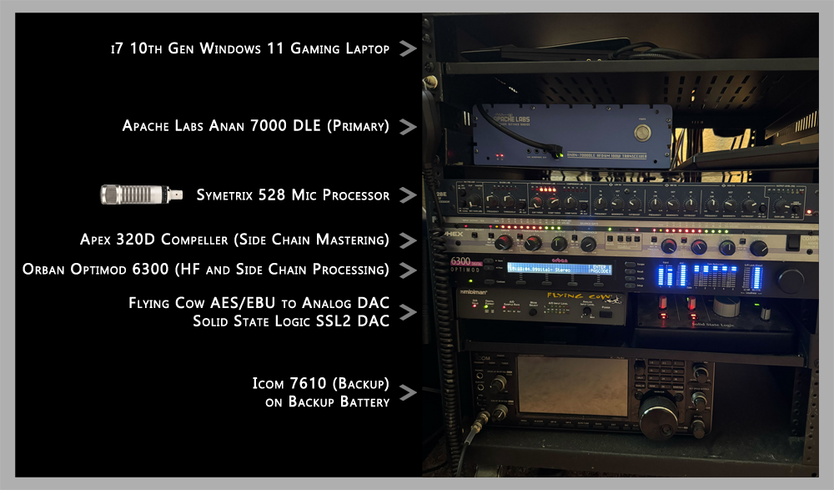

Slide 4
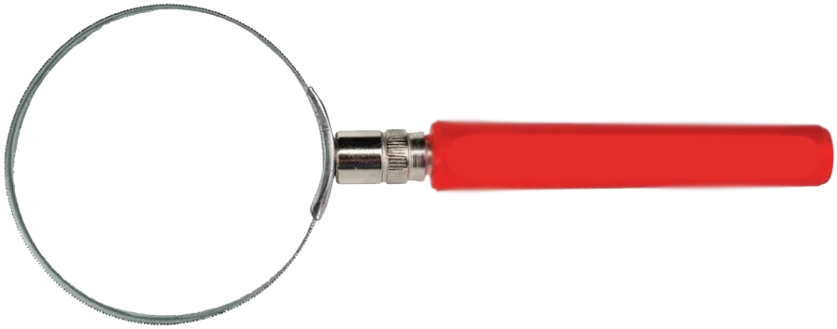
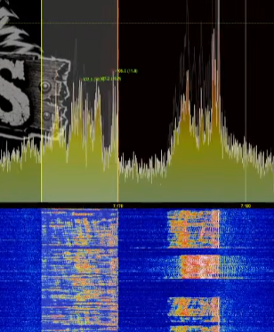
DID YOU KNOW YOU'RE SPLATTERING?
It's a very common misconception that ESSB signals take up unnecessary bandwidth.
It's incredibly common that the person coming to tell us we're "splattering" is actually running dirty or putting out harmful IMD.

Slide 5
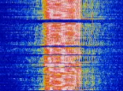
THE IMD STORY
Your signal contains many simultaneous tones. If the PA or driver stages aren't perfectly linear, those tones mix and produce sum/difference products at frequencies outside your intended passband heard by others as "splatter" on adjacent frequencies.
Strong nearby signals mix in the front end and create phantom signals on frequencies where nothing is transmitting. Quantified by IP3 (third-order intercept point) and dynamic range figures in receiver reviews.
In the example on screen, the station is transmitting a standard 100Hz - 2.9Khz but their IMD has them occupying over 6Khz.

Slide 6
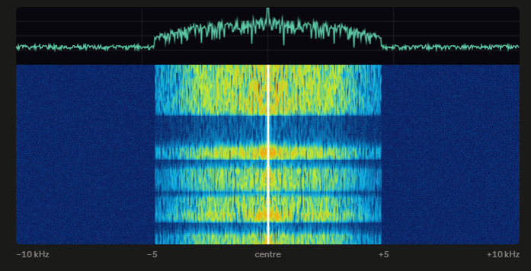
IS ESSB LIKE AM?
Similar in bandwidth, YES
Similar in sound quality, YES
Where AM differs:
Center Carrier
Signal Width (more below)
Duty Cycle
Standard AM signals are 6Khz wide occupying 3Khz on either side of the center frequency. Important to note that while the standard is 6Khz, many AM stations run 8Khz or above.
What gives AM away instantly is the bright, rock-steady vertical line dead center. That's the carrier and it's there whether or not anyone is talking, and it's typically the strongest thing on the trace since in unmodulated AM the carrier holds all the power.

Slide 7
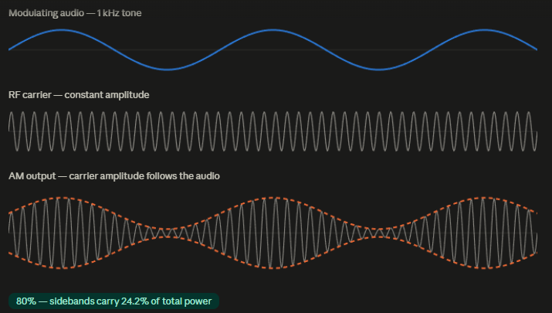
WHY NOT JUST USE AM?
Ideally for some of the same reasons
and then some.
The Dreaded Double
Lower Power on AM
Less Efficient on AM
Standard ESSB stations
and 3Khz LSB stations
can co-exist together
Better Fidelity

Slide 8
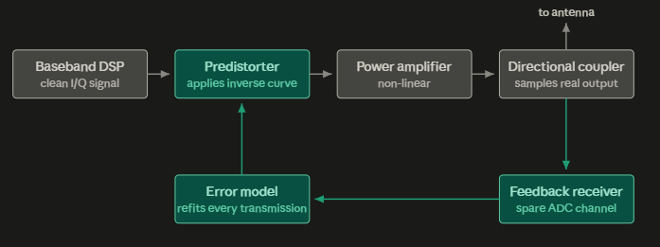

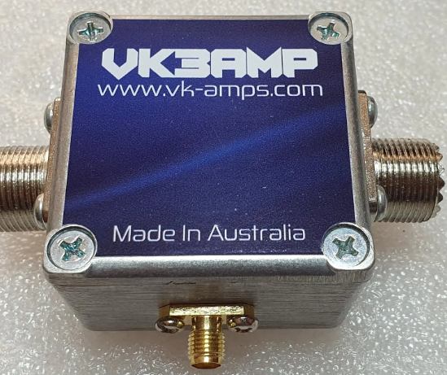
WHY DO ESSB'ers LIKE CHEESE SO MUCH?
Pure Signal / Adaptive Pre-Distortion
Rather than backing the amplifier off until it behaves, you deliberately distort the signal going in with the mathematical inverse of whatever the amplifier does, so the two cancel and the output comes out linear.
PureSignal is Warren Pratt NR0V's implementation of this for the OpenHPSDR/Apache Labs ANAN radios. FlexRadio's equivalent is SmartSignal, and Icom ships a version too called DPD.

Slide 9
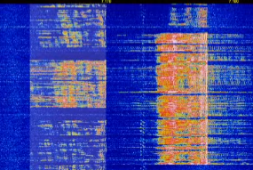
EXAMPLE OF 1.5KW SIGNAL
PURE SIGNAL / SMART SIGNAL THE OTHER GUY
6Khz = All Audio 10Khz = 3Khz Audio + 7Khz of IMD

Slide 10
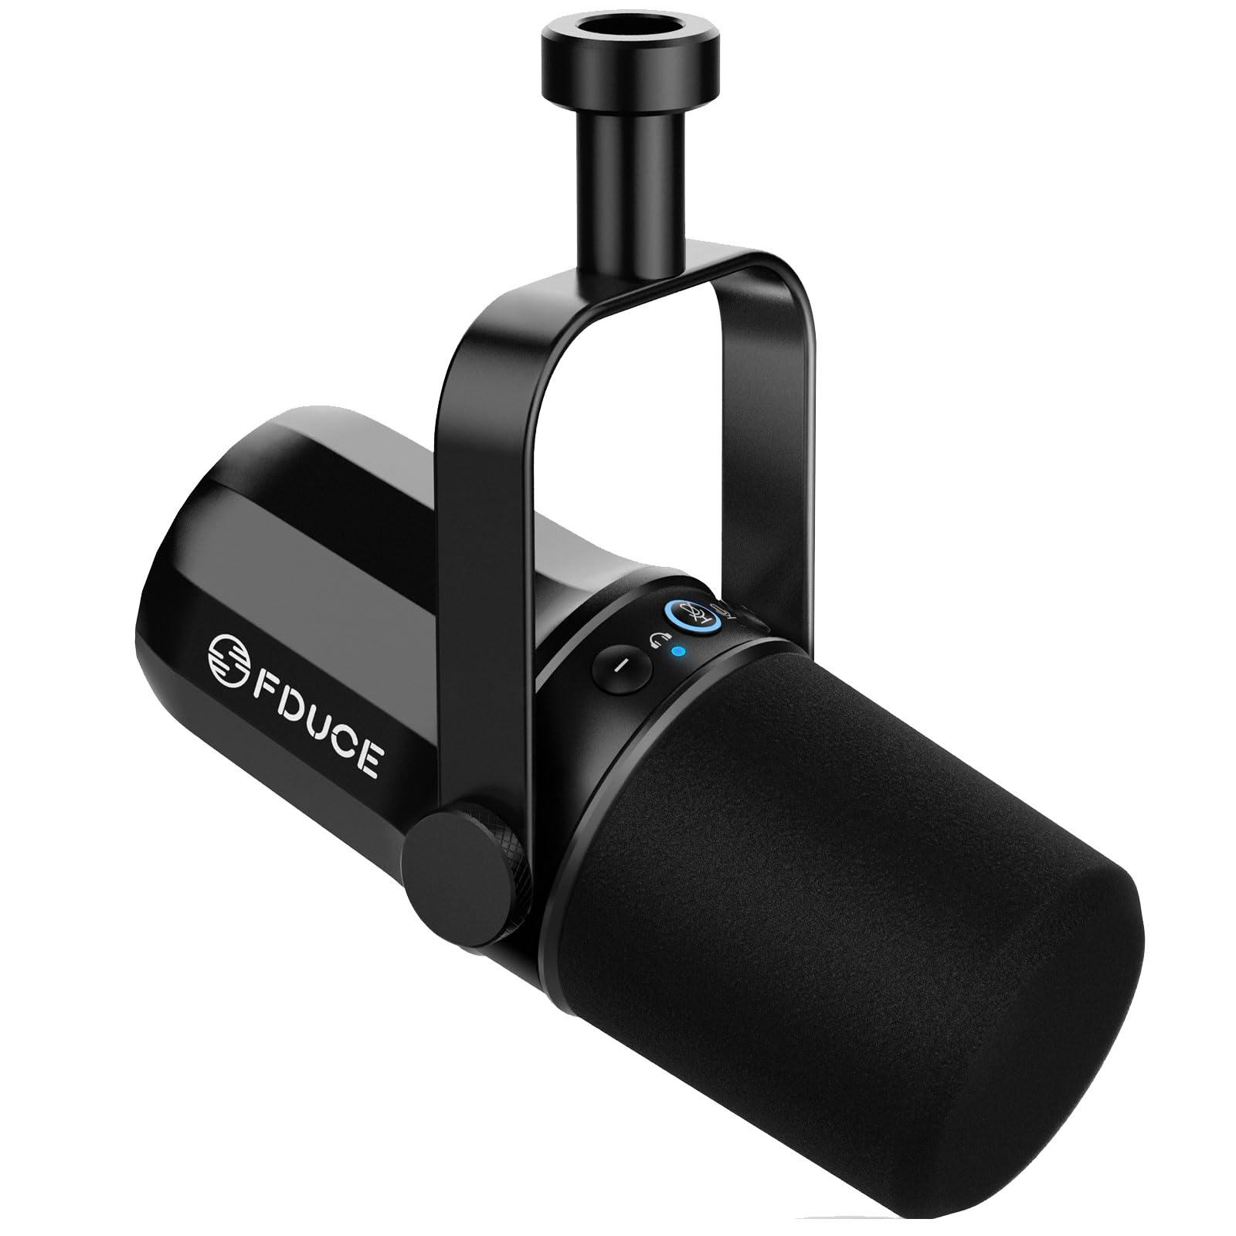
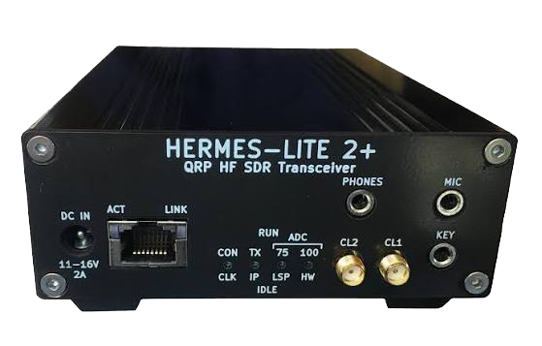
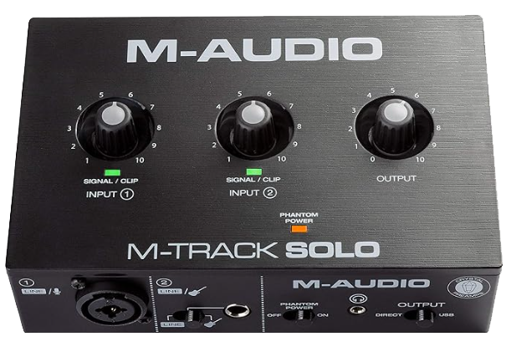

HOW DO I GET STARTED ON A BUDGET?
FDUCE SL-40 M-AUDIO DAC HERMES LITE 2
$45 $55 $270

Slide 11


THANK YOU
For more information, visit www.n6mud.com or check out the ESSB Audio Outlaws (N6MUD)
channel on
YouTube.

